Slide 1




YOUR NAME : ABDUL REHMAN
COHORT: 7
TRAINER: MUHAMMAD RAEES AZAM PROJECT NAME:
AI COMPLAINT
WRITER

Slide 2



Course Overview
2
Introduction
Generative AI
In the "Generative AI" course, I gained hands-on experience with AI techniques used in real-world applications across industries. The course spanned 3 months and included both theoretical learning and practical projects. I learned Python programming from basics to advanced, explored machine learning, natural language processing, GANs, VAEs, ChatGPT, prompt engineering, and transformers. The course also covered ethical AI practices and showcased how This journey equipped me with both technical and ethical perspectives to develop AI-driven solutions.

Slide 3






Skills Learned
3
CHAT BOTS
LLM
STREAMLIT

Slide 4





About Project
4
Project Title
Why you Choose it
AI Complaint Writer
Many people face problem but don’t know how to write a good complaint. Writing in formal English is difficult for many user, especially students or the general public. I want to solve this real-world problem using AI and make the process easier.
What it Does
This project help user write professional complaint letters using AI. The user enters some detail like issue type and description. The AI automatically generate a well-Written complaint letter. User can copy or download the letter to send to the concerned department.
Any Challenge Faced?
The biggest challenge was generating clear and professional language from short user inputs. Making the app simple and user-friendly took multiple UI design attempts. Some time the AI gave long and unrelated answers, so I had to fine-tune the prompts carefully.

Slide 5
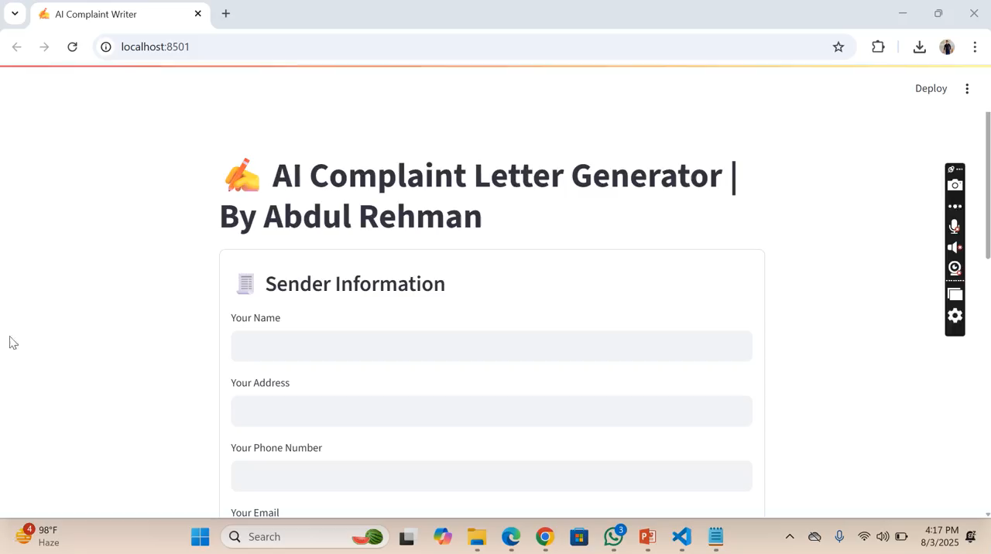
Project Demo/Screenshot
5
Key Points:
1. This project automatically generates formal
complaint letters using AI.
2. Users enter basic details like name, address,
and complaint text.
3. The system supports both English and Urdu
complaint letters.
4. The generated letters are saved as text files
for download or printing.
5. It helps users write professional complaints
easily without manual formatting.

Slide 6
Impact/Outcome
6
What did you achieve?
How did the project help you grow?
This project helped me understand how Generative AI works. I learned how to turn user input into a proper complaint letter. It improved my skills in Python and using AI tools. I also improved my thinking and problem-solving skills.
I created an AI Complaint Writer that makes formal letters in English and Urdu. It takes user inputs like name, address, and complaint text. Users can select the language of the complaint. It formats the letter automatically.

Slide 7
Whats Next?
7
Fillonlyinthesectionyouwill choose
Freelance?
Startup?
Job?
After completing this project, I
can now work as a freelancer by
offering AI-powered complaint
letter writing services. People who struggle to write
formal letters can get professional
help easily. This project opened a new way for
me to earn through online
platforms like Fiverr or Upwork.
This project can be turned into a startup idea by launching a platform that helps people write formal complaints using AI. It can support multiple languages and formats for schools, companies, and government services.
This project strengthened my technical and communication skills, which are valuable for tech jobs. It shows that I can build real-world AI solutions from scratch. Such experience can help me get a job in AI development, software engineering, or automation.

Slide 8
Acknowledgement / Thank You
8
I would like to thank AKTI Team for providing me this valuable learning opportunity. Special thanks to my trainer, Muhammad Raees Azam, for his excellent guidance and support throughout the project. This project has been an important step in my AI learning journey — thank you all!
Thank you AKTI Team & Trainer

Slide 9


THANK YOU
Regards: Abdul Rehman

